Slide 1


CSCI 5541: Natural Language Processing
Lecture 1: Class Overview
James Mooney, University of Minnesota

Slide 2
Overview
Instructors
Course information
Grading and Late Day Policy
Class Participation
Homework
Project
Reading Assignment
Outline of Topics
Computing resources

Slide 3
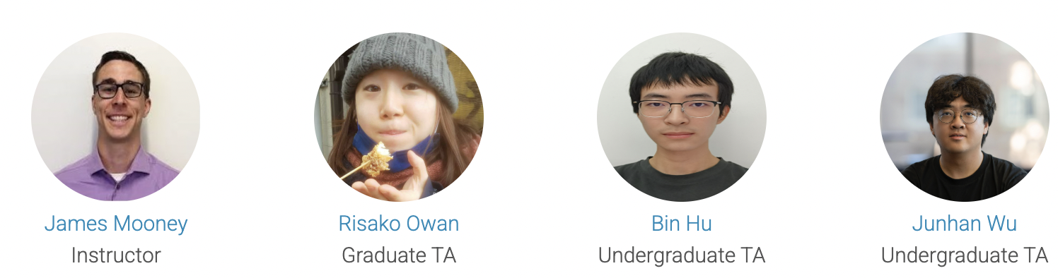
Instructors
James: Friday 3pm - 4pm via Zoom
Risako: TBD
Bin: TBD
Junhan: TBD

Slide 4
Course Information
Class meets:
Tuesday and Thursday, 4PM to 5:15PM
Lind Hall L125
UNITE / Remote (recording will be available for everyone right after the class)
Class homepage
https://jimtmooney.github.io/Courses/S25/index.html
HW/Project discussion on Slack
https://csci5541s25.slack.com/
HW/Project submission and grading on Canvas
canvas.umn.edu/courses/483164

Slide 5
Outline
The purpose of this course is to provide an overview of the computational techniques developed to enable computers to understand and respond appropriately to ideas expressed using natural languages.
This course will cover a broad range of computational models in NLP,
from language representations, to development and evaluation of NLP applications, to practical coding/machine-learning skills to implement them.
text classification, distributional representation methods of language, large language models, and advanced techniques used in chatGPT

Slide 6
IMPORTANT NOTE for background
This course covers NLP techniques based on recent deep learning models, assuming students' knowledge of basic machine learning
This course focuses practical learning of NLP knowledge
Programming & reading assignments and a semester-long project
Assignments and project require programming with PyTorch
We use Python for programming and LaTex for report writing
If students are not familiar with either one of the fields, they should consider dropping the course as it would be very challenging and the course is not designed to cover all aspects.

Slide 7
Prerequisite
Required:
CSCI 2041 Advanced Programming Principles
CSCI 5521 Machine Learning Fundamentals,
Recommended but not mandatory:
CSCI 5527 Deep Learning, or
Any other relevant course that covers fundamental machine learning algorithms.
Furthermore, this course assumes:
Background in basic probability, linear algebra, and calculus.
Good coding ability, corresponding to senior undergraduate CS major.
Assignments will be in Python with PyTorch.

Slide 8
What we don’t cover in this class (1)
Classical ML techniques and NLP algorithms
E.g., SVM, HMM, CRF, Viterbi
Take CSCI 5521 Machine Learning
Advanced techniques for NLP models
E.g., GNNs, Recursive Nets, Diffusion, latent variable models,
Take CSCI 5980 NLP with Deep Learning
Human aspects of AI and NLP systems
E.g., interaction design, formative/field study, Qual analysis, theory grounding
Take CSCI 5115 User Interface Design or other HCI classes

Slide 9
What we don’t cover in this class (2)
Linguistic aspects or computational linguistics:
Take classes in Institute of Linguistics https://cla.umn.edu/linguistics/graduate/courses
Basic Python programming skills
Basic tutorials on PyTorch and HuggingFace programming will be given by TAs

Slide 10
8980 vs 5980 vs 5541
Some lectures will be shared across the three classes but they have different focuses;
5980 (NLP with Deep Learning)
focuses on more "processing" parts of NLP, particularly with deep learning methods.
8980 (Intro to NLP Research)
covers broad aspects of NLP research, including theory grounding, data annotation, error analysis, emerging topics, and applications to different fields.
5541 (NLP, this course)
is an introductory class to cover some basic computational methods with applications and representations, and learn practical skills to apply them to your work
55XX (Large Language models, TBD)
is an advanced course that cover a broad ranges of LLMs from technical knowledge, to latest learning methods, to applications, to societal impacts

Slide 11
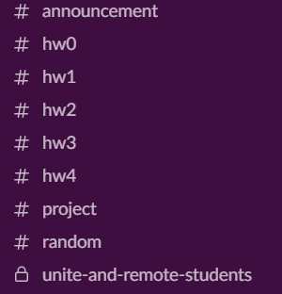
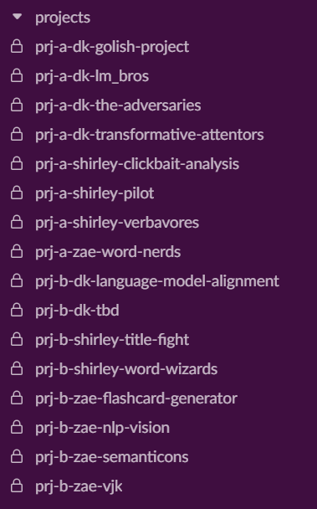
Class Slack
https://csci5541s25.slack.com/
Slack will be the primary method of communication.
A separate channel for UNITE/Remote students
“prj-[A/B]-MENTOR-TEAMNAME”
With instructors
“prj-[A/B]-TEAMNAME”
Without instructors
Group A/B
Mentor
Project name

Slide 12
Slack communication etiquette
Don’t ask about homework via emails or Direct Messages to TAs;
Questions MUST be posted in the homework channel (e.g., hw#1, hw#2) or during TA's office hours.
Technical / coding questions should follow the stack overflow format
<Error message> + context <what you tried so far>
Responses outside office hours (9-6pm) will be delayed
Be respectful and supportive
Anyone can respond to each other (Slack participation point). Feel free to answer others' questions if you have already addressed similar issues.

Slide 13
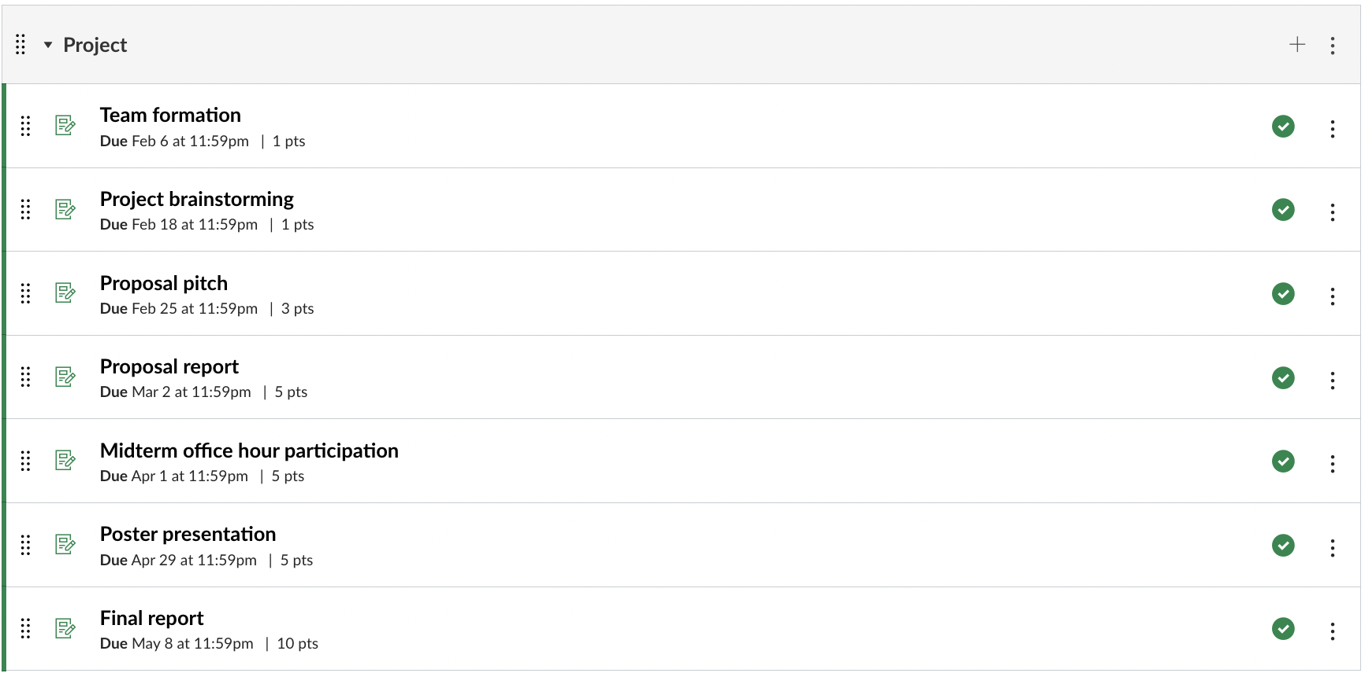
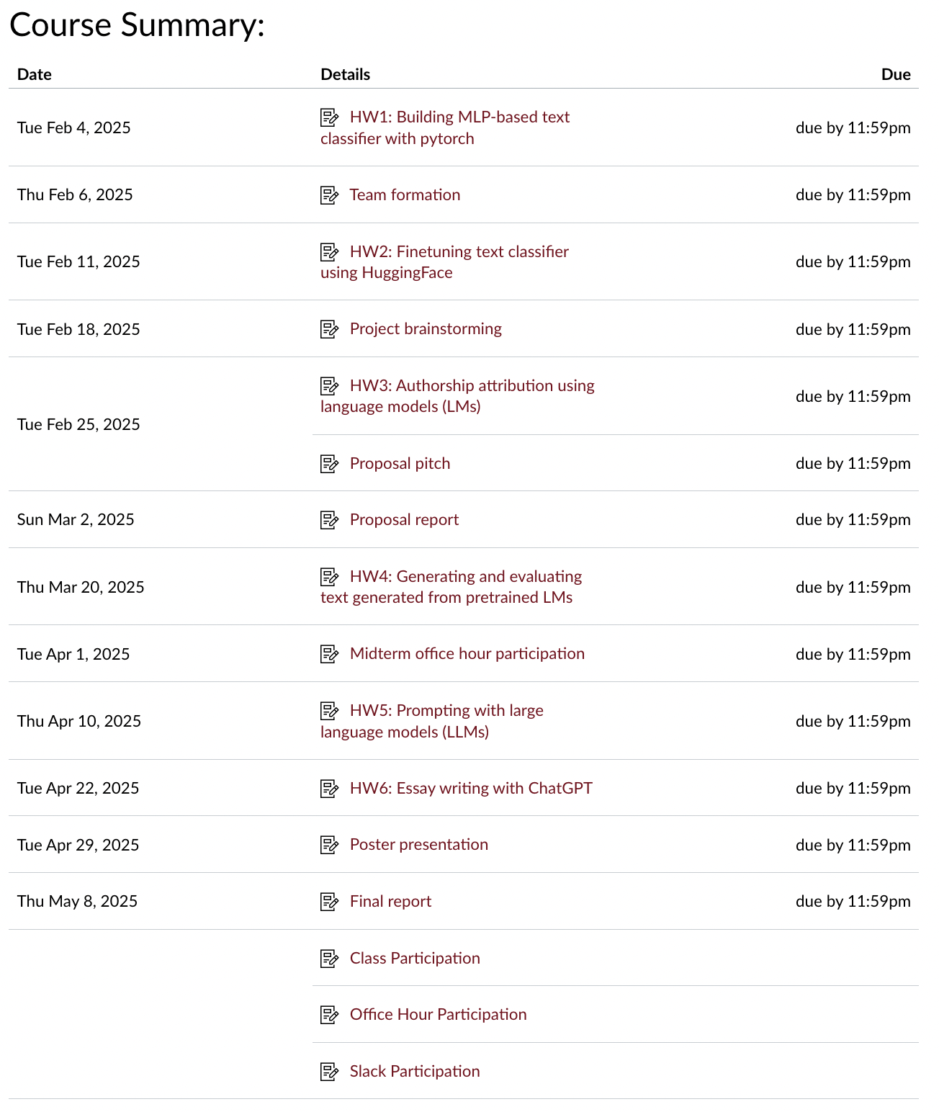
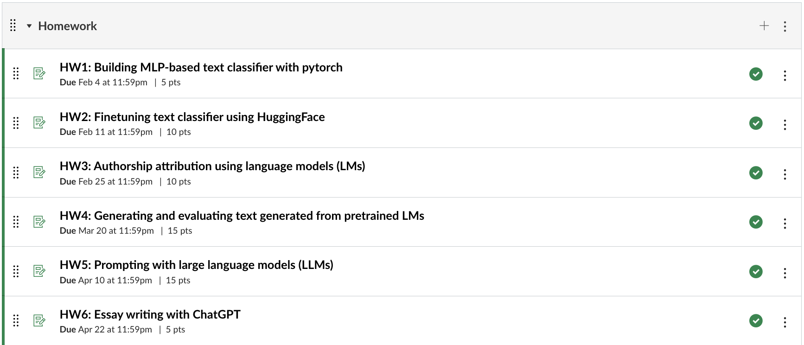
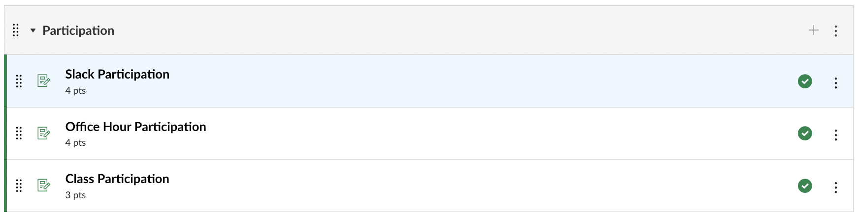
Canvas
canvas.umn.edu/courses/483164

Slide 14
Grading and Late Day Policy
60% Homework (hw1/2/3/6 for individual, hw4/5 for team)
30% Project (team)
10% Class Participation (individual)
Each student will be granted 5 late days to use for homework and reading assignment over the duration of the semester. After all free late days are used up, penalty is 1 point for each additional late day.
The late days and penalty will be applied to all team members for group homework and project.
DRC and other medical urgencies can only be accommodated with a doctor’s note or a letter from the DRC

Slide 15
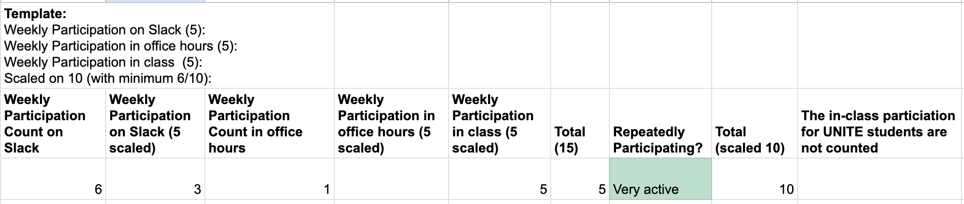
Class participation (10%)
Your class participation is thoroughly evaluated.
The following metrics will be used to grade your participation:
Participation and discussion in class (no count for UNITE/Remote students)
**Discussion on Slack and during Office Hours for both instructor and TAs
Discussion and QA during the presentation of the project proposal and poster
We explicitly count the number of your offline and online participation, and (min/max) normalize them at the end of the class.
Your participation score will be zero if you haven't participated in class, Slack or other discussions.

Slide 16
Homework Details (60%)
HW1, 2, 3 and 6 are individual assignments
HW4 and 5 are team assignments (the same team for projects)
Team assignments
Maximum of 4 people
Submit your team information by Feb 6
All questions regarding homework MUST be communicated with the lead TA over Slack homework channels (e.g., #hw1) or during their office hours.

Slide 17
Homework Details (60%)
The use of outside resources (books, research papers, websites), collaboration (students, professors) or AI tools (ChatGPT) are encouraged but MUST be explicitly acknowledged. Check out the Academic Integrity policy (https://jimtmooney.github.io/Courses/S25/index.html#note).
The deadline for all homework is by midnight (11:59PM) of the due date. Since our schedule is quite tight, there will be no deadline extension, but you can still use your late days. For the delayed team homework and project, late days for every team member will be used.

Slide 18
Use of AI Tools (e.g., chatGPT)
Encouraged to use AI tools like ChatGPT, CoPilot, etc.
You can use it to:
Clarify concepts learned in class
Get instant answers to your questions before emailing TAs and instructor
Test your knowledge by asking it questions
Warning:
Please properly mention what kinds of help you get from the tools in your homework and project (missing acknowledgement will be treated as cheating)
Use the tools with responsibility:
Generative AI tools often hallucinate and only provide general answers

Slide 19
Homework Details (60%)
HW1: Building MLP-based text classifier with pytorch
5 points, Individual, due: Feb 4
HW2: Finetuning text classifier using HuggingFace
10 points, Individual, due: Feb 11
HW3: Authorship attribution using language models (LMs)
10 points, Individual, due: Feb 25
HW4: Generating and evaluating text from pretrained LMs
15 points, Team, due: Mar 20
HW5: Prompting with large language models (LLMs)
15 points, Team, due: Apr 10
HW6: Essay writing with ChatGPT
5 points, Individual, due: Apr 22

Slide 20
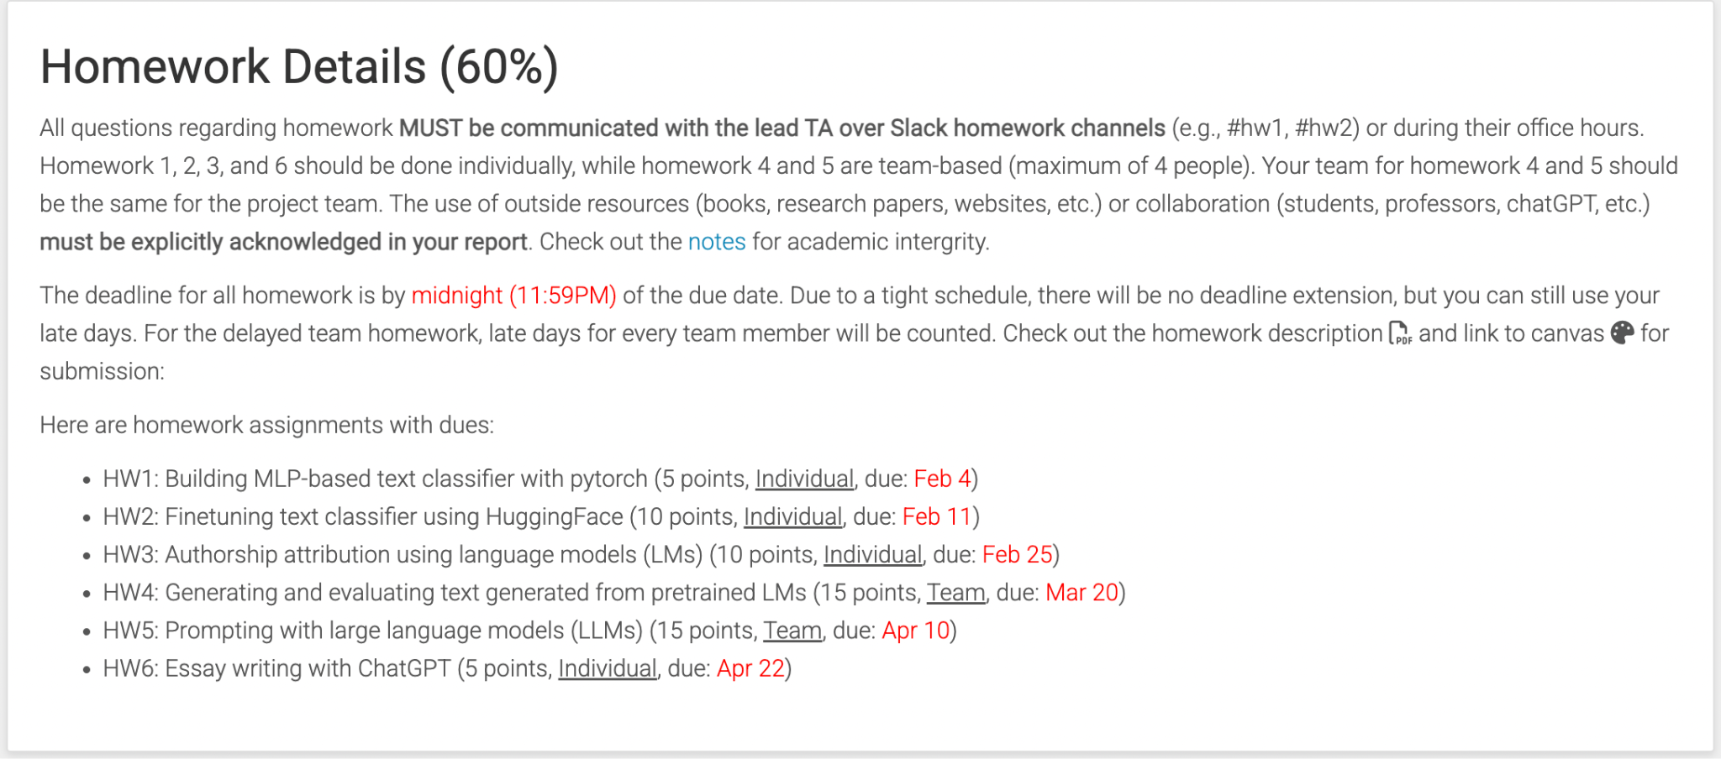
Homework Details (60%)
https://dykang.github.io/classes/csci5541/F24/#homework

Slide 21
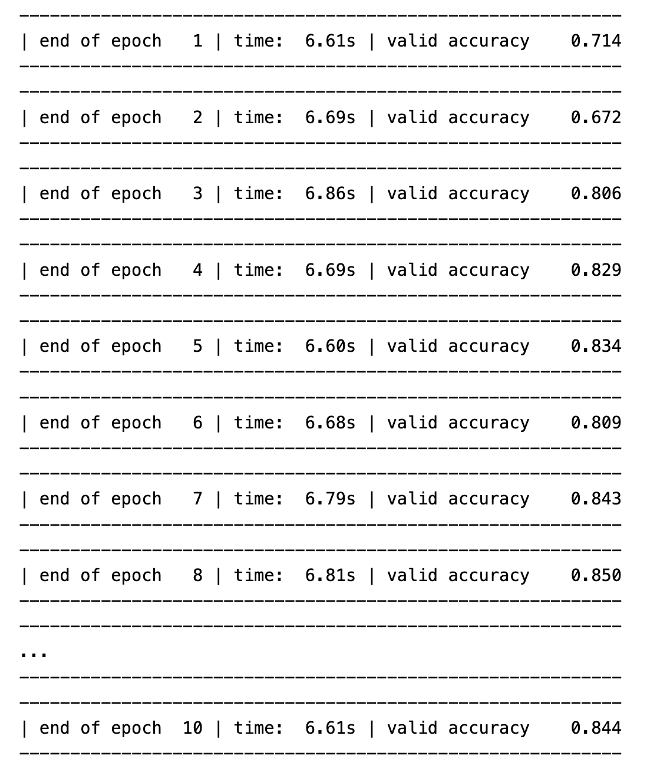
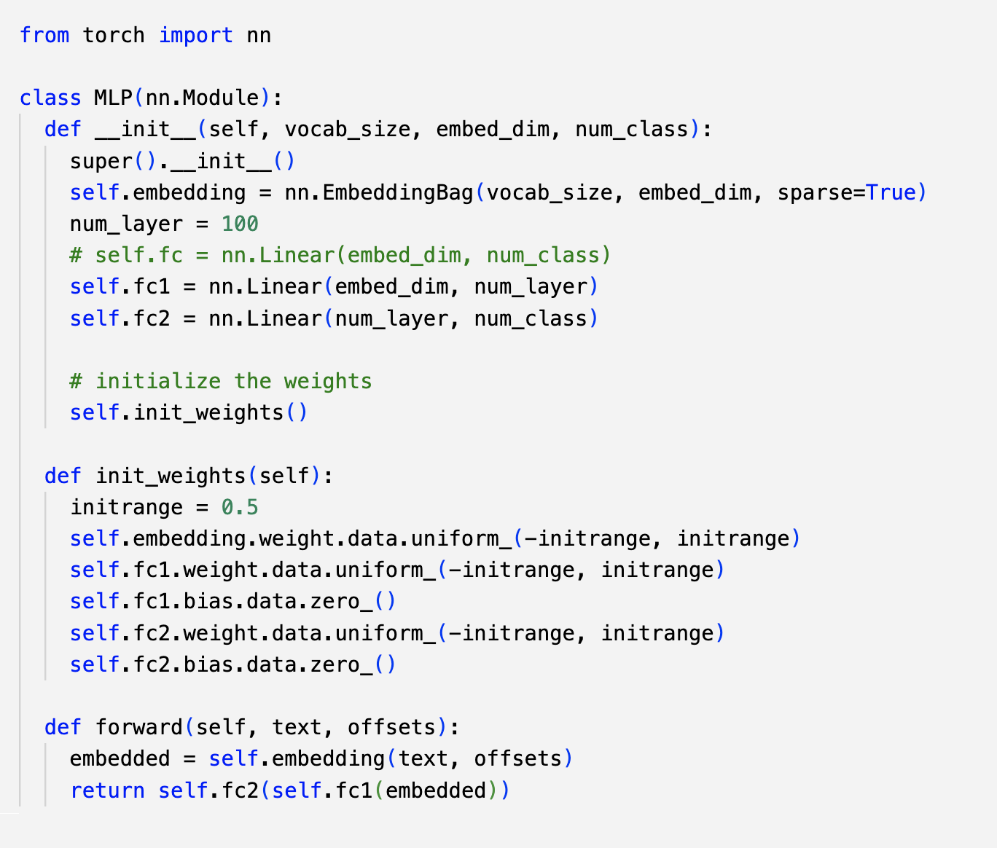
HW1: Building text classifier with pytorch
Does my classifier learn something?

Slide 22
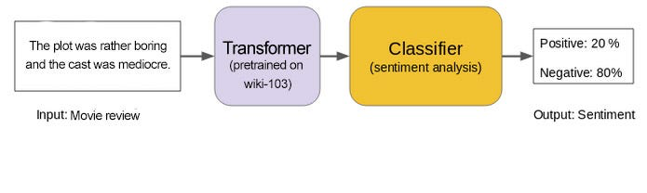
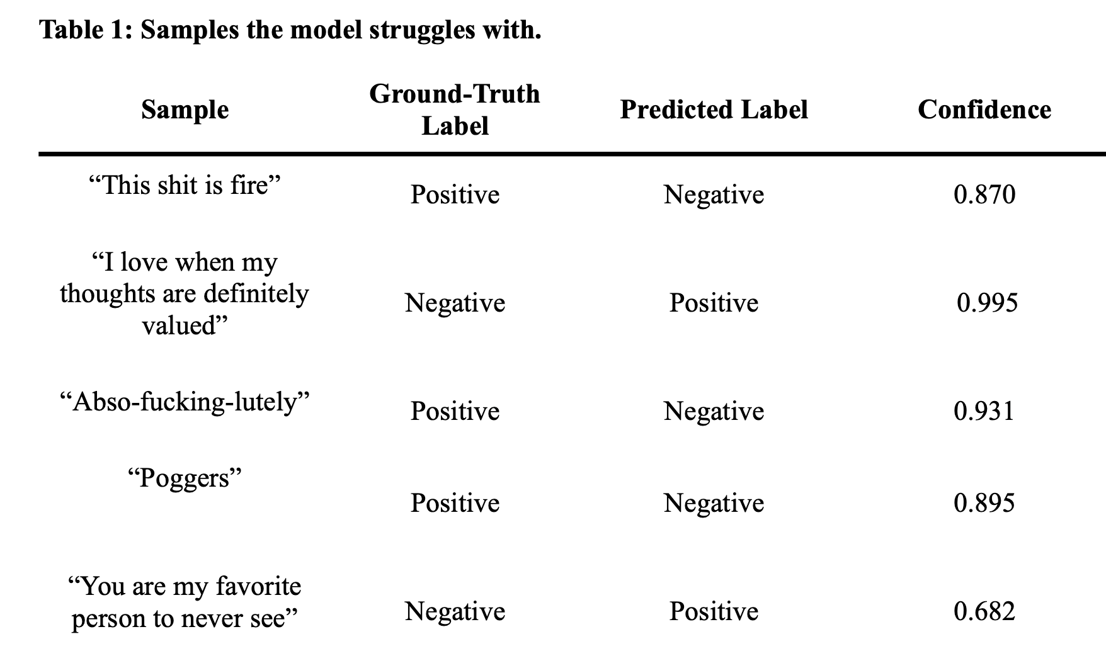
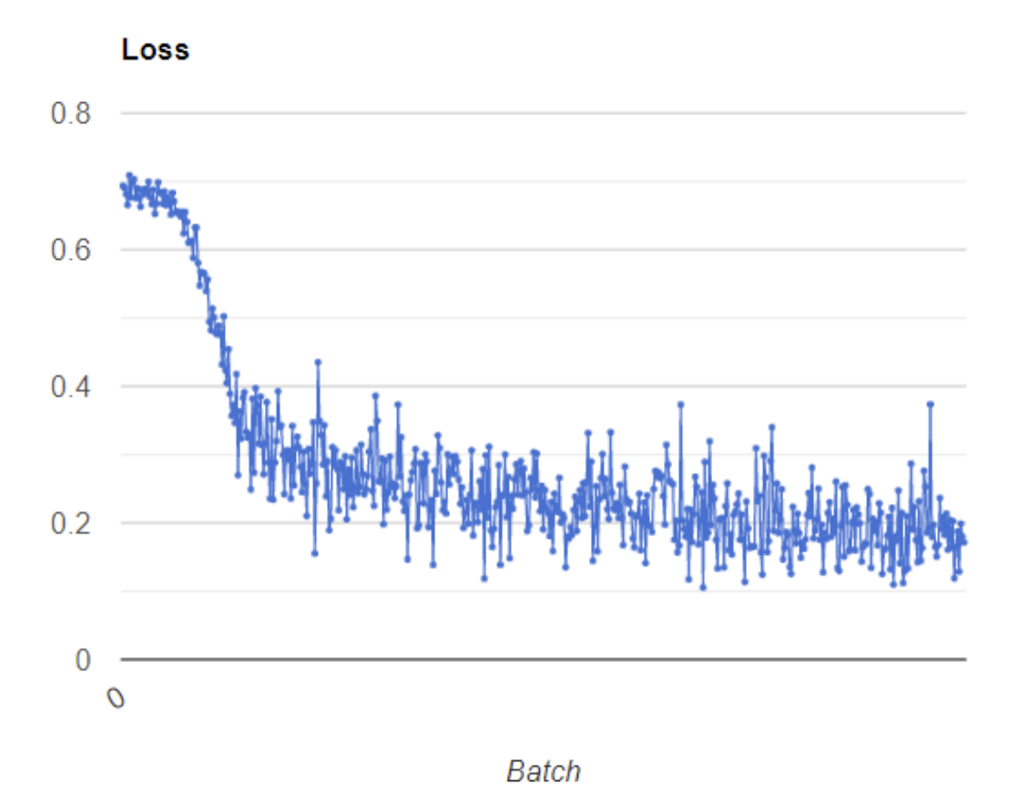
HW2: Finetuning text classifier using HuggingFace
Finetuning a pretrained text encoder
How to make sure my training/fine-tuning is correctly learning the task?
In which cases, does the fine-tuned classifier make mistakes?

Slide 23
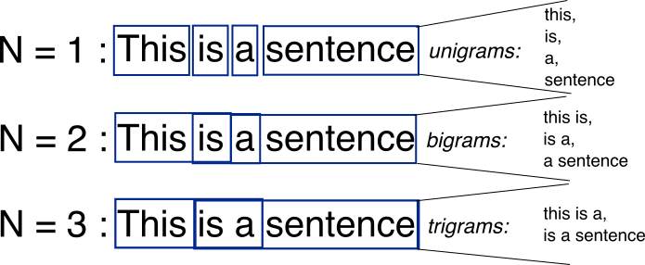
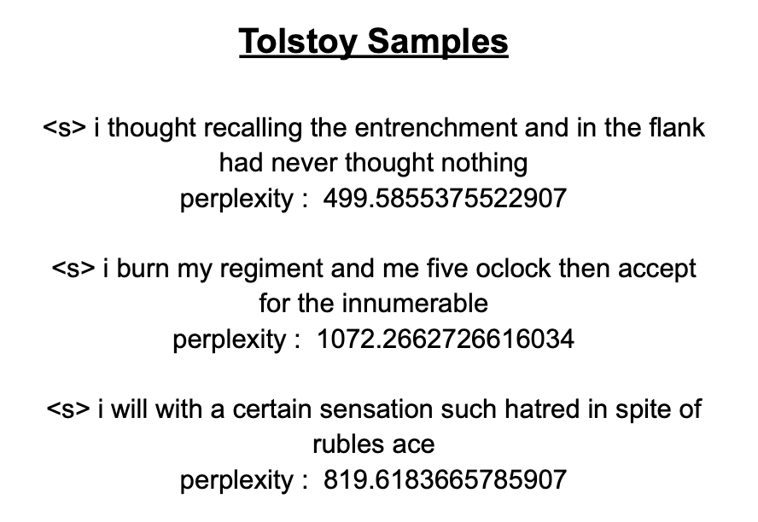
HW3: Authorship attribution using language models
How plausible is text as Tolstoy language?
Written by Tolstoy? Or Written by Hamlet?

Slide 24

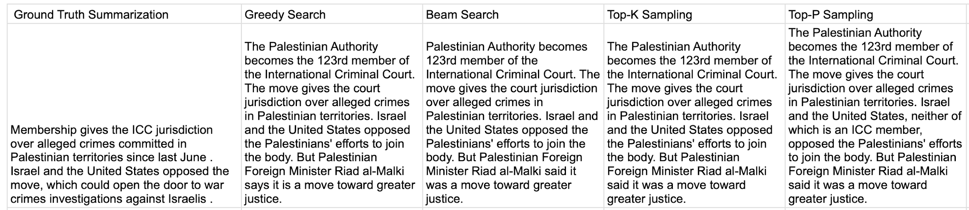
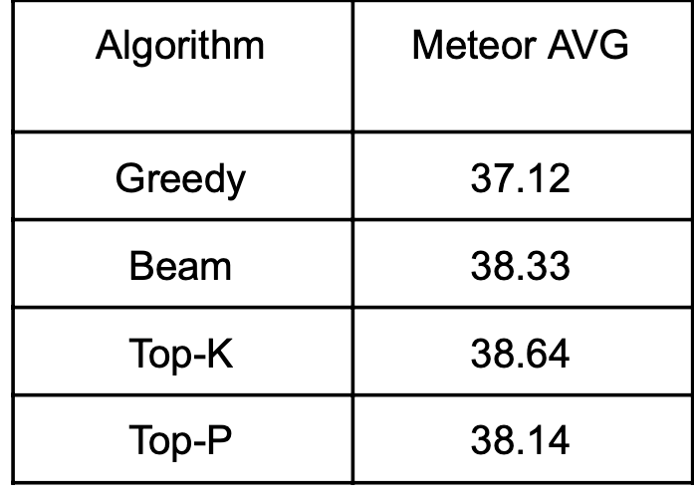
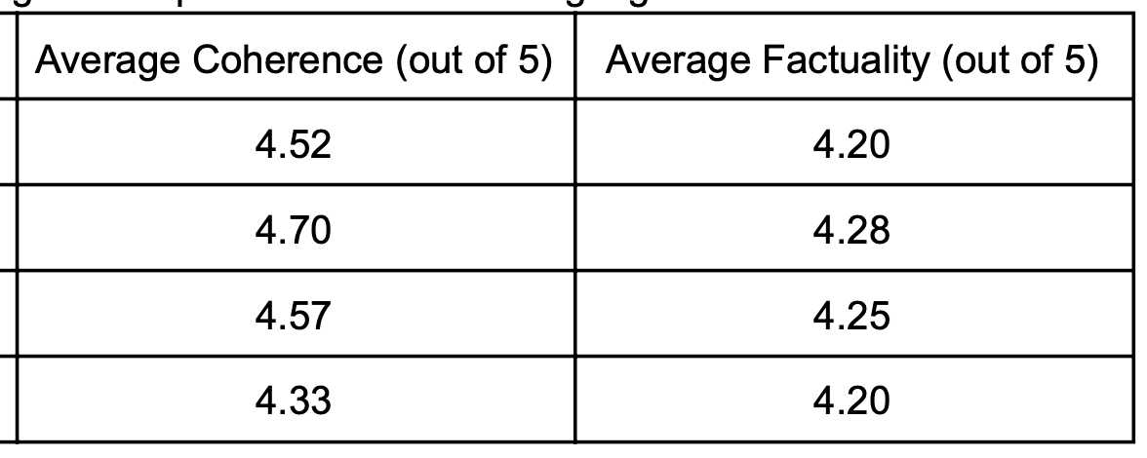
HW4: Generating and evaluating text from pretrained LMs
Different versions of generated text/summaries using various decoding algorithms
How to evaluate the generated text against the human’s summary?
Other aspects humans evaluate text summaries?

Slide 25

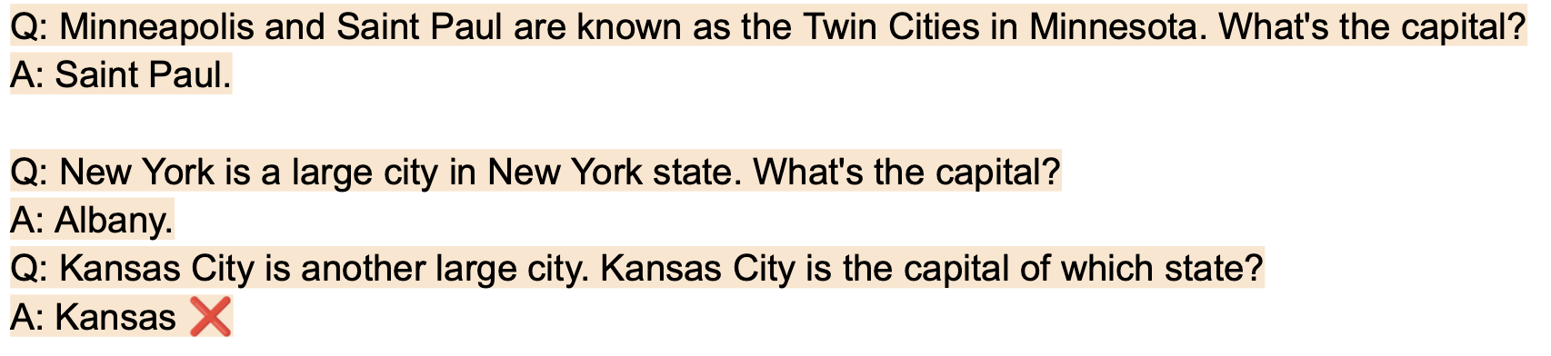
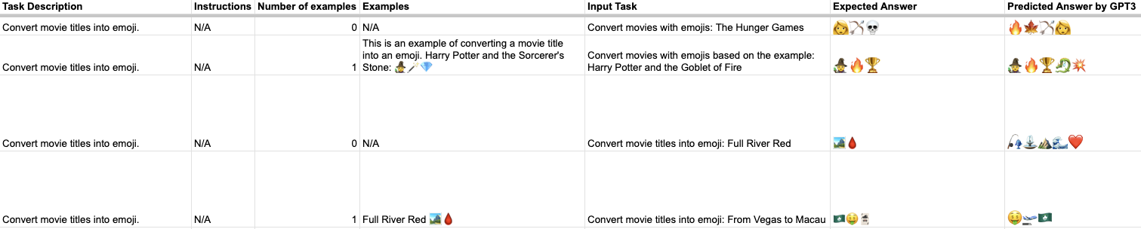
HW5: Prompting with large LMs

Slide 26

HW6: Essay writing with ChatGPT
Q2 [Education]. How would the classroom look in the future? Do you believe AI will impact and reshape the classroom and education? If you can learn most of what you need from chatGPT or other LLMs, what is the role of teachers? What do you expect students to learn in the classroom?

Slide 27
Project Goal
A course project would be one of the following types:
New research results judged suitable for acceptance to a NLP or ML workshop,
Critical analysis of existing NLP models or datasets,
Collection of your own dataset on new problems or adversarial datasets that can fool the existing systems ,
An in-depth literature survey on emerging topics,
Interactive demonstration (e.g., Chrome Extension, Flask) or visualization of existing systems,
New open-source repository or dataset with a high impact on the community
Please carefully read the project guideline first (can be found here)

Slide 28
Project Evaluation Rubric
HWs are generously graded but the projects are not! Therefore, students should consider the potential contribution of the projects rather than trying to play it safe. Playing it safe won’t give them full marks.
Three important rubrics:
Novelty: Compared to the state-of-the-art methods/systems/datasets, how novel is your approach?
Significance: How strong is your result? Is your finding still holding if different setups or prompting tricks?
Clarity: How clear and easy-to-follow is your report? Do you have well organized presentation of your results and problem definition?
https://jimtmooney.github.io/Courses/S25/rubrick.html

Slide 29
Project Deliveries and Dues (30%)
Team formation (1 point, due: Feb 6)
Project brainstorming (1 point, due: Feb 18)
Proposal pitch (3 points, due: Feb 25 and 27)
Proposal report (5 points, due: Mar 2)
Midterm office hour participation (5 points, due: Apr 1)
Poster presentation (5 points, due: Apr 29 and May 1)
Final report (10 points, due: May 8)

Slide 30
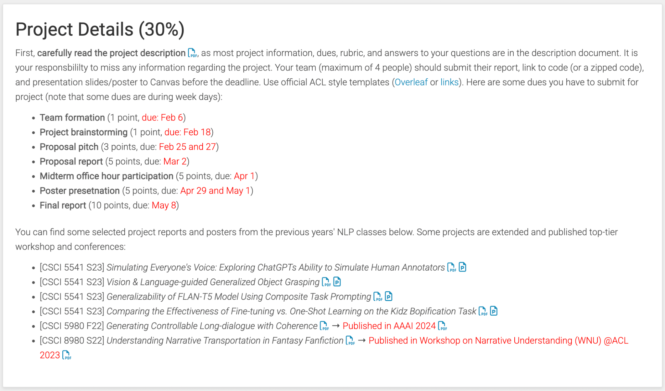

Slide 31
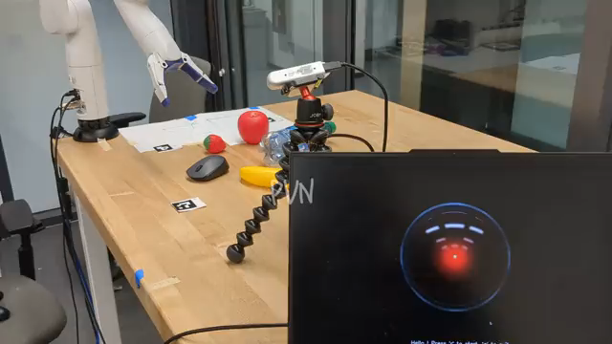
VLanGOGh: Vision and Language guided Generalized Object Grasping
CSCI 5541 Spring 2023
Nikhilanj Pelluri

Slide 32
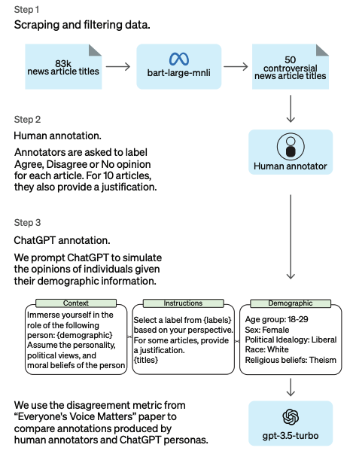
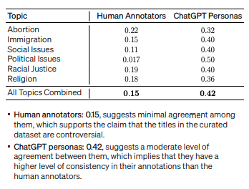
Simulating Everyone’s Voice: Exploring ChatGPTs Ability to Simulate Human Annotators
CSCI 5541 Spring 2023
Abdirizak Yussuf, Claire Chen, Dinesh Challa, Venkata Sai Krishna

Slide 33
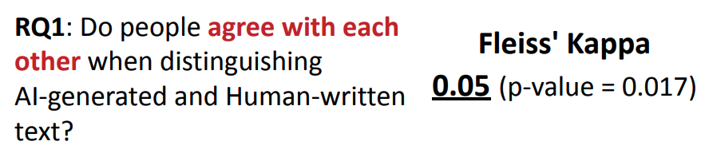
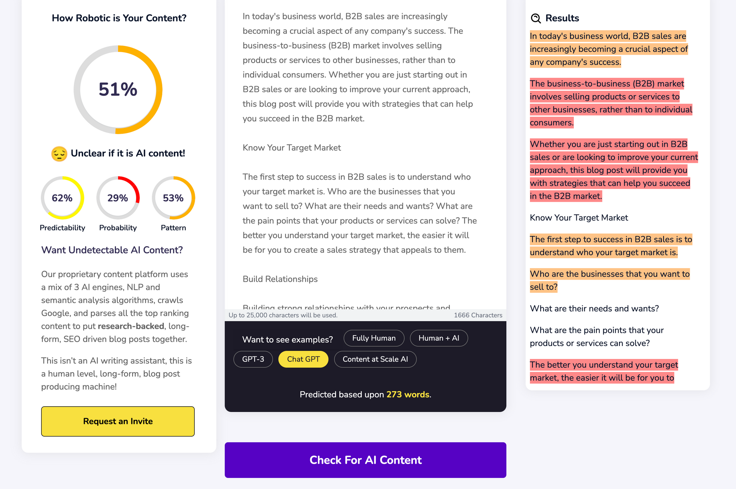
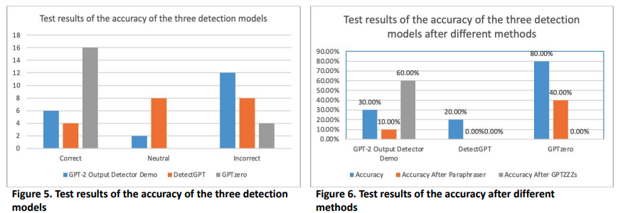
Who is speaking? Distinguishing Artificial Intelligence Generated and Human Written Text
CSCI 5541 Spring 2023
Moyan Zhou, Mingsheng Sun, Yutong Sun

Slide 34
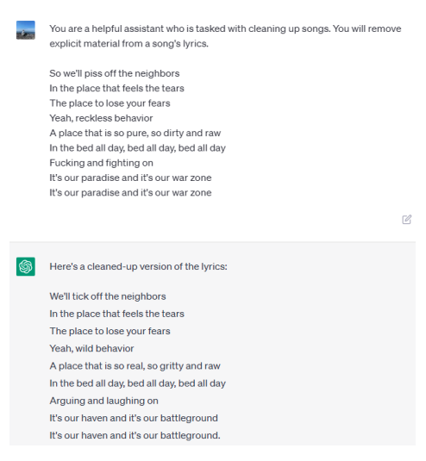
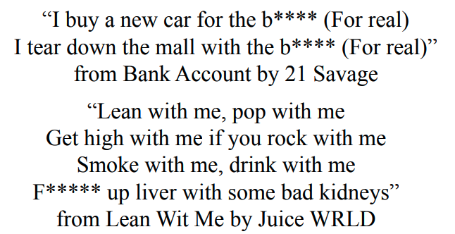
Comparing the Effectiveness of Fine-tuning vs. One-Shot Learning on the Kidz Bopification Task
CSCI 5541 Spring 2023
Jeonghoon Kim, Matthew Olson, Marco Berriodi

Slide 35
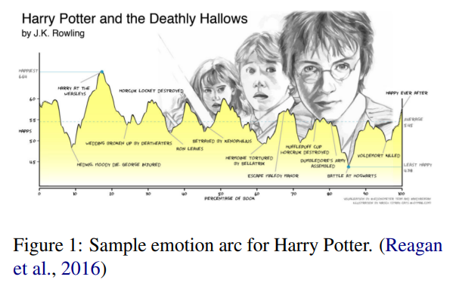
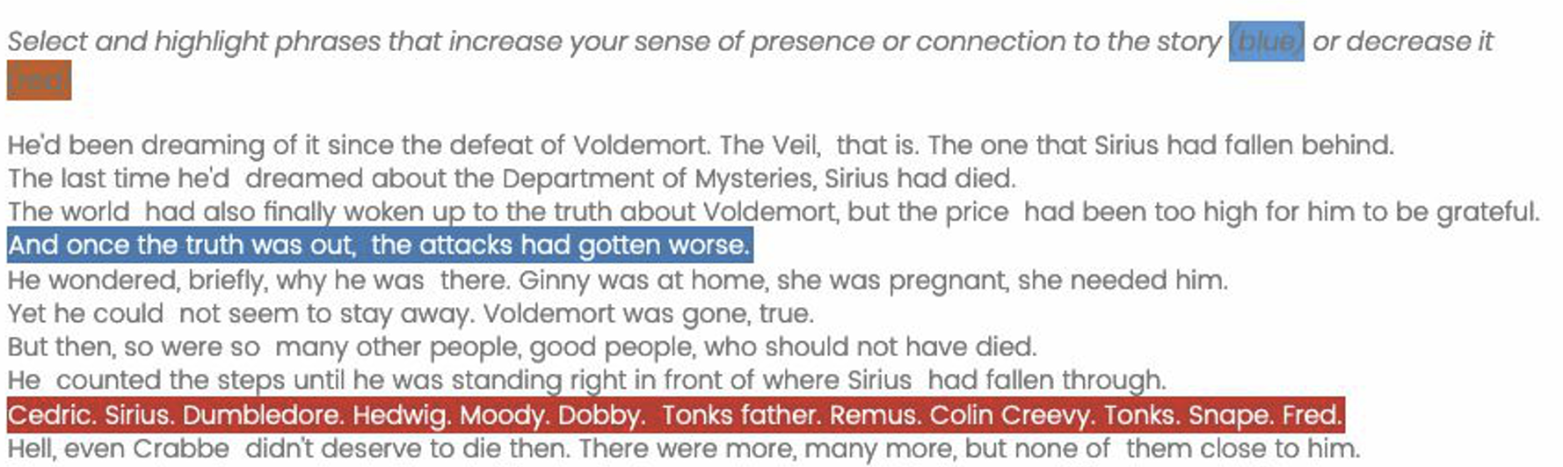
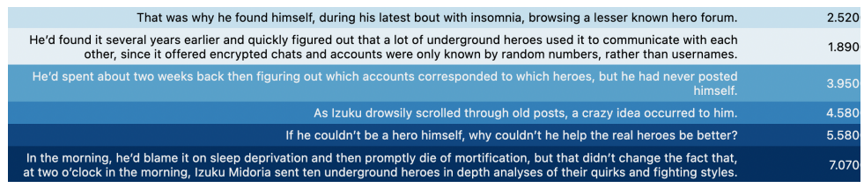
Understanding Narrative Transportation in Fantasy Fanfiction
CSCI 8980 Spring 2022
Kelsey Neis, Yu Fang
Published in Workshop on Narrative Understanding (WNU) @ACL 2023 https://arxiv.org/abs/2306.04043

Slide 36
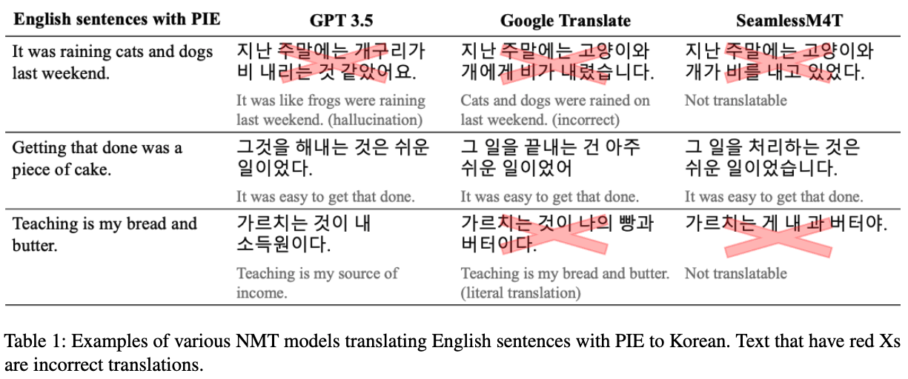
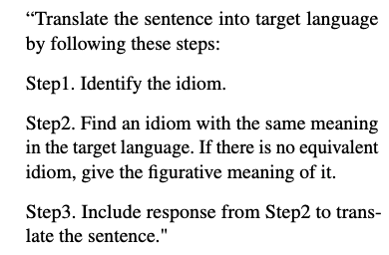
Transidiomation: Optimizing translation of idioms embedded in text
CSCI 5541 Spring 2024
Dhondup Dolma, Jaeeun Lee, Yongtian Ou, Jiyoon Pyo Team NLPitch

Slide 37
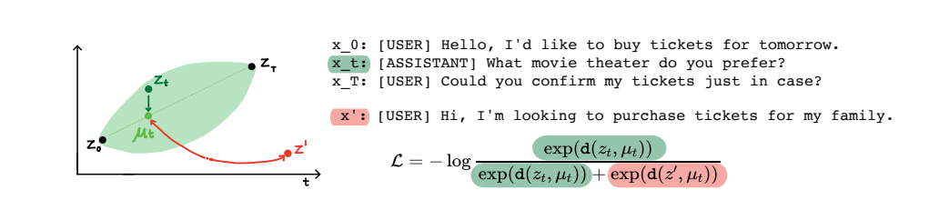
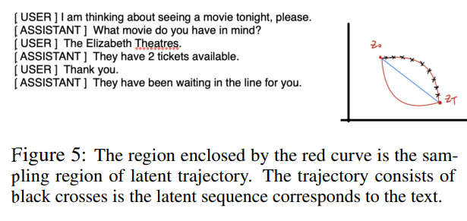
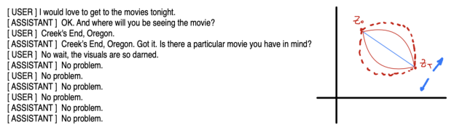
Generating Controllable Long-dialogue with Coherence
CSCI 5980 Fall 2022
Zhecheng Sheng, Chen Jiang and Tianhao Zhang
Time control in language model using Brownian bridge (Wang et al., ICLR 2022)
Published in AAAI 2024, https://arxiv.org/abs/2312.16893

Slide 38
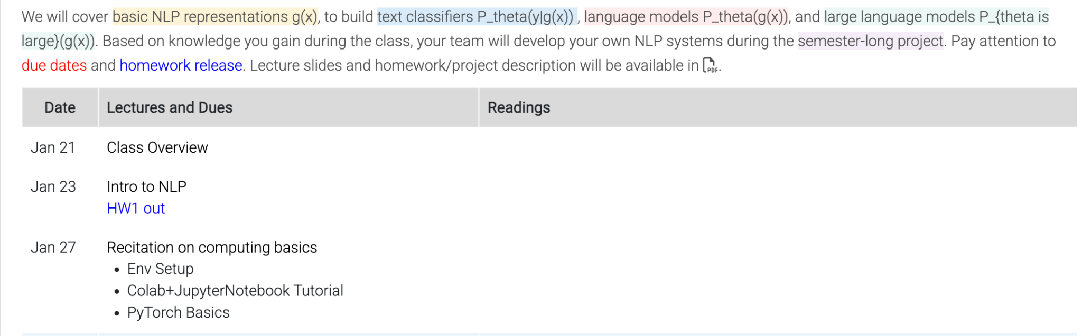
Topics

Slide 39
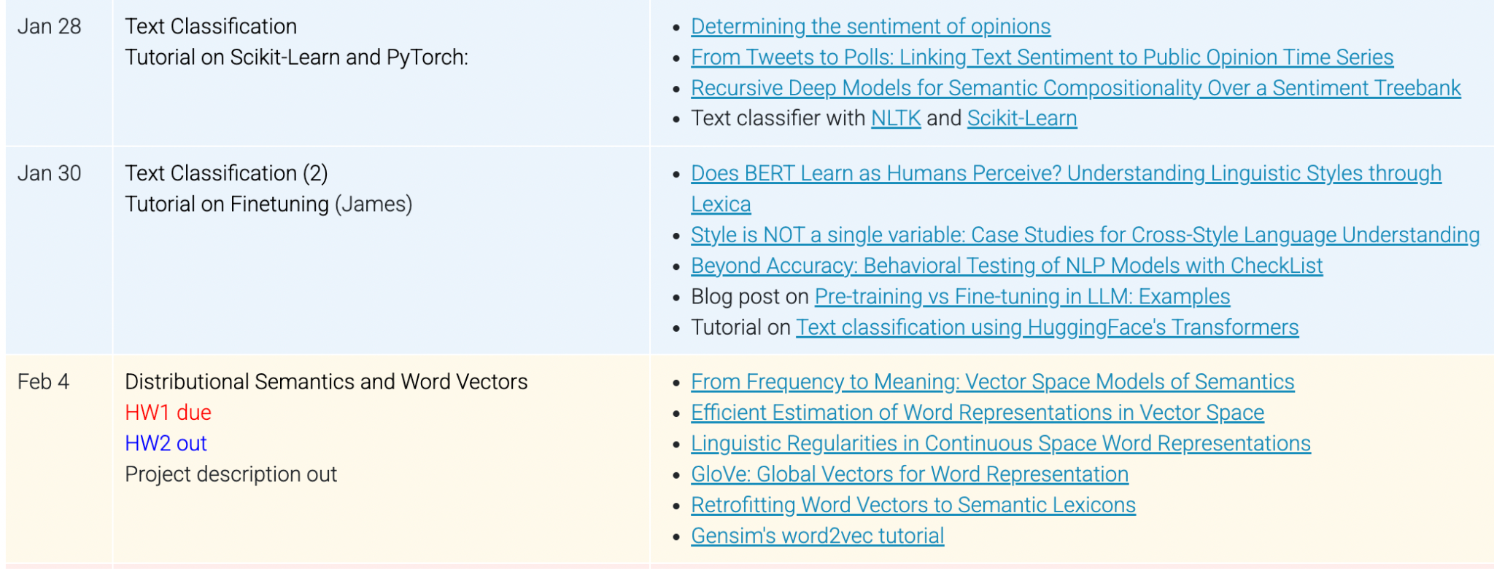
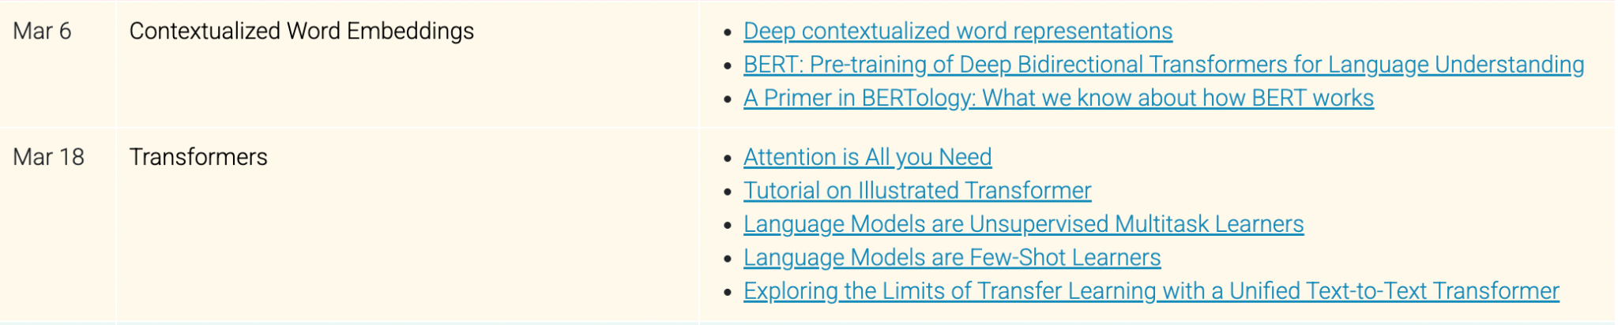
Topics
Text classification
Programming Tutorials
Finetuning Tutorial
Basic representations
Distributional semantics
Contextualized word embeddings
Self-Attentions and Transformers

Slide 40
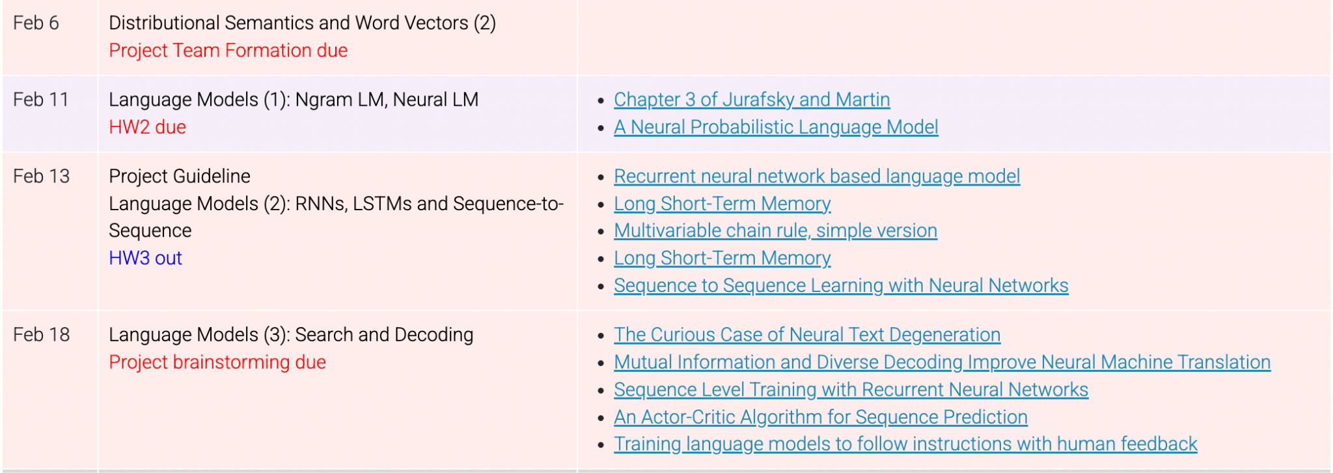
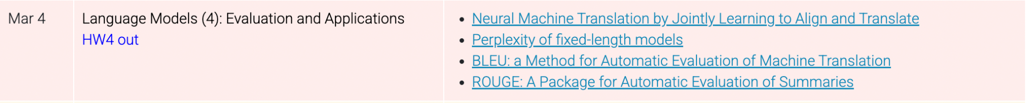
Topics (cont’d)
Language Models
Ngram LM, Neural LM, RNN, LSTM, and seq2seq
Search and decoding
Search in Training
Evaluation
Applications

Slide 41
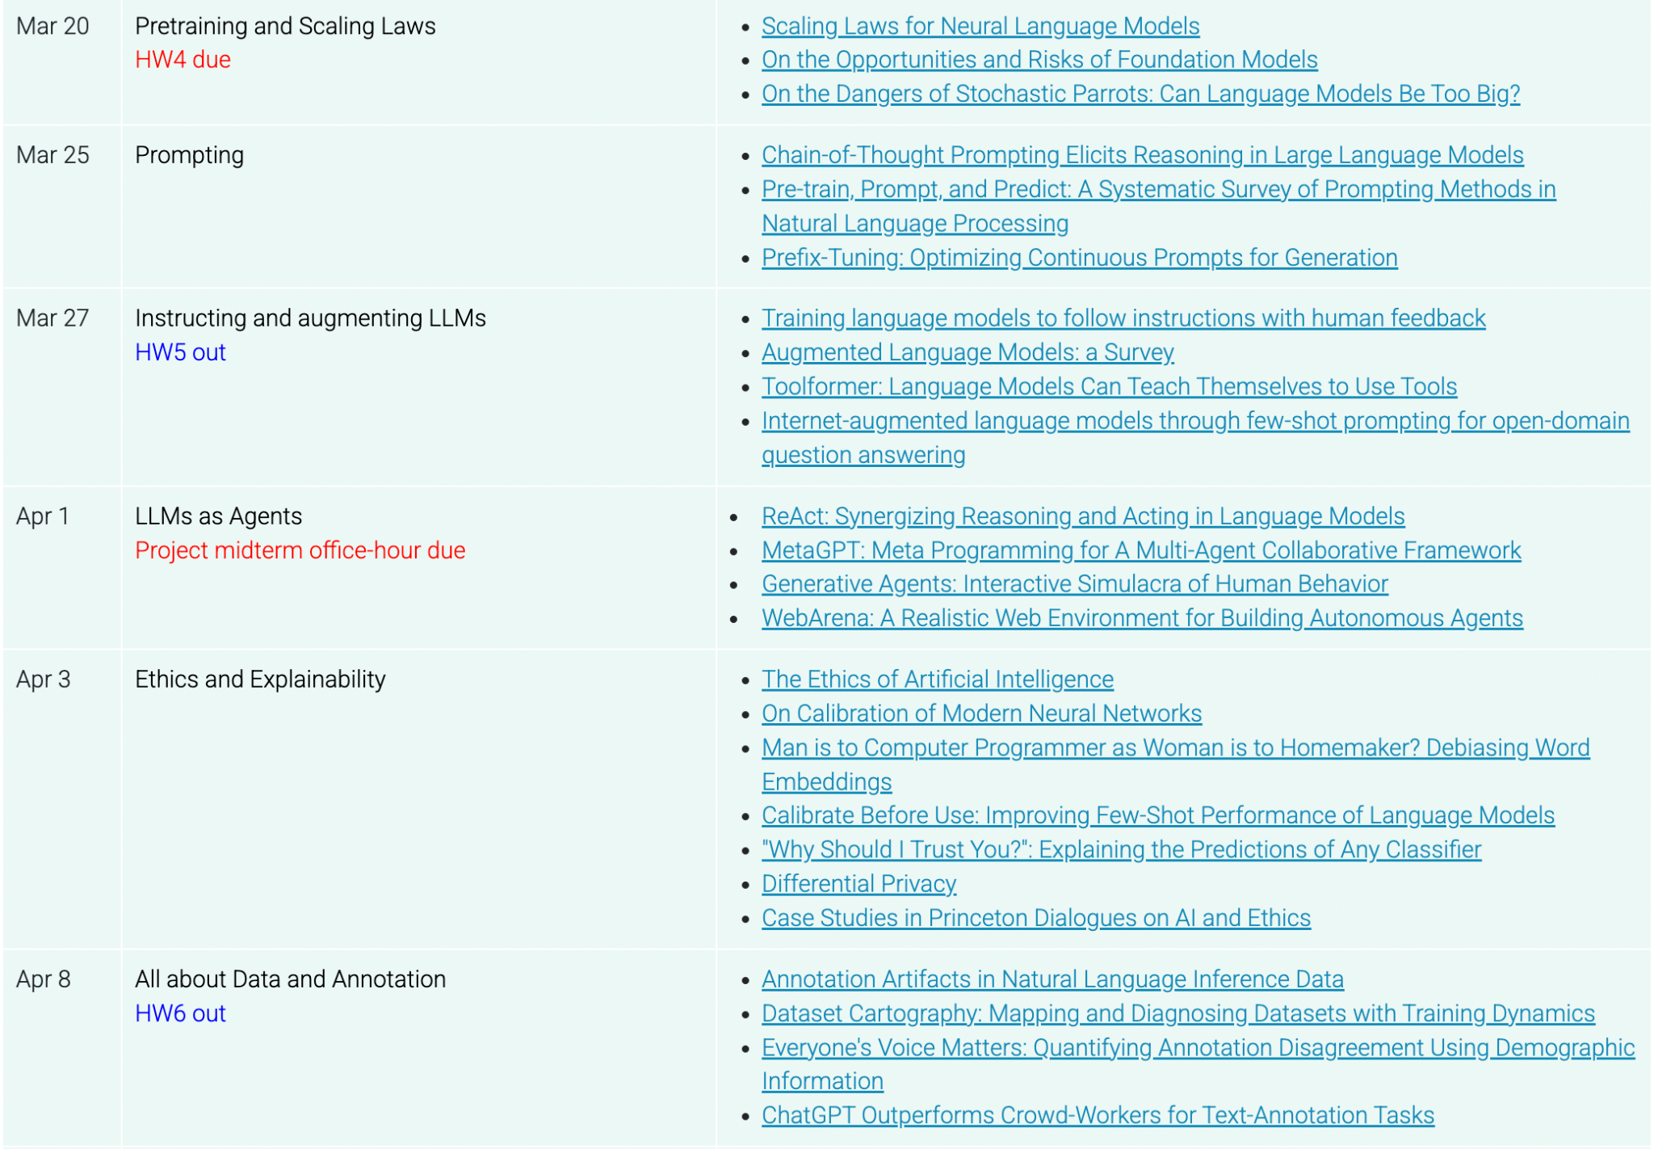
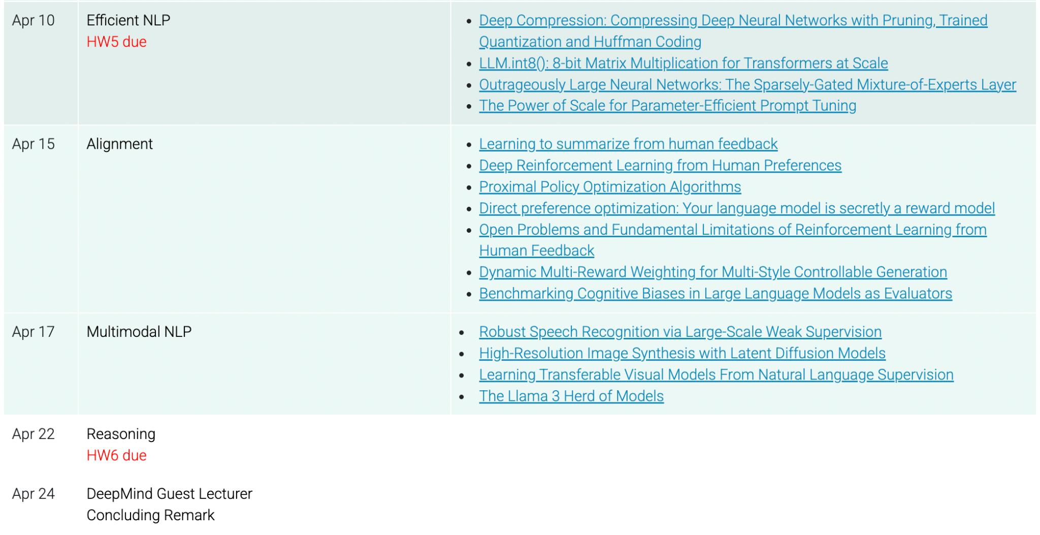
Topics (cont’d)
Large language models:
Pretraining and scaling laws
Prompting
Instructing and augmenting LLMs
Multi-agents, agentic workflow
Alignment and RLHF
Efficient NLP
Ethics and safety
Societal alignment or Multimodal LM
Data, annotation, and evaluation
Reasoning, Guest Lecture

Slide 42
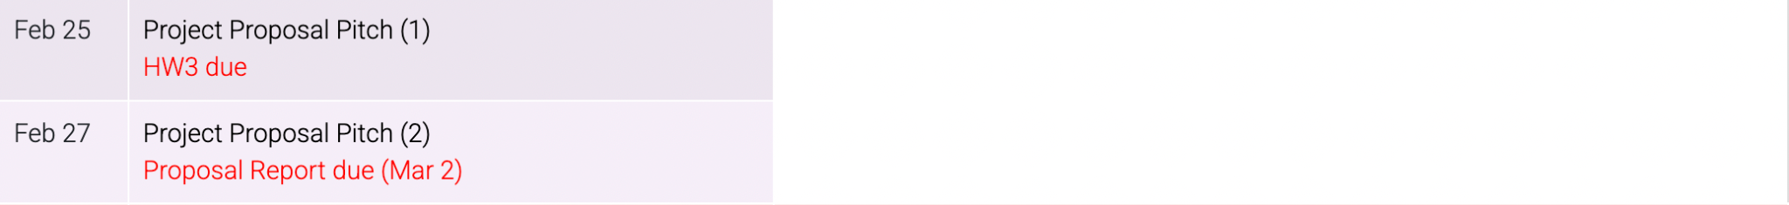
Topics (cont’d)
Project:
Project guideline
Project Proposal Pitch (Group A and B)
Final Project Poster (Group B and A)

Slide 43
Textbook
The lecture slides and reading list will be posted on the class site at least one day before the class.
Textbook is not required but the following books are primarily referred
Jurafsky and Martin, Speech and Language Processing, 3rd edition [online]
These course materials are inspired by the slides from Stanford, UC Berkeley, and CMU.

Slide 44
Academic Integrity
Everything you turn in must be your own work, and you must note the names of anyone you collaborated with on each problem and cite any resources (e.g., chatGPT prompts you used) that you used to learn about the problem.
If you have any doubts about whether a particular action may be construed as cheating, ask the instructors for clarification before you do it. Cheating in this course will result in a grade of F for course and the University policies will be followed.

Slide 45
Computing Resources
Reimbursement for Google Colab Pro by CS&E department (Updated soon)
https://docs.google.com/document/d/1Kdo6BN1h2yISYHTTSC6DVLWhNEaEcRxk/edit?usp=sharing&ouid=102305309222832534233&rtpof=true&sd=true
LLM API Endpoints (Updated soon)

